Slide 1
ENSE 470, Milestone 6
DCC
Dakota Fisher, Chengyu Lou, Connor Meredith
March 28, 2018

Slide 2
Executive summary
Technology used
MySQL/MariaDB, PHP, JavaScript, HTML, CSS
XAMPP/LAMP
GitHub
All features specified by MVP were completed
Very few changes to lo-fi prototypes were made

Slide 3
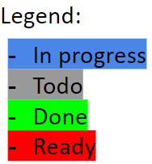
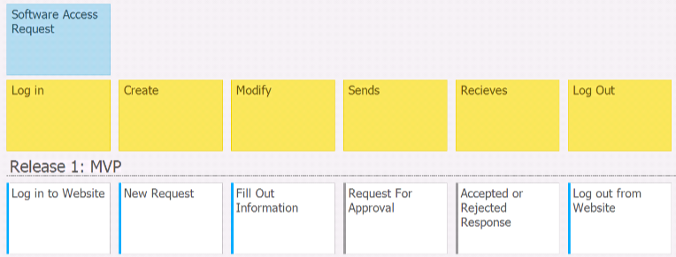
Software User User Story Map
Team DCC: Dakota Fisher, Chengyu Lou, Connor Meredith

Slide 4
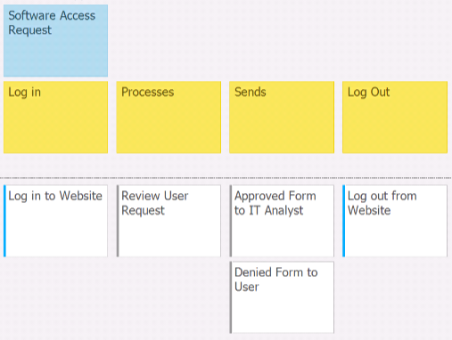
Approver User Story Map
Team DCC: Dakota Fisher, Chengyu Lou, Connor Meredith

Slide 5
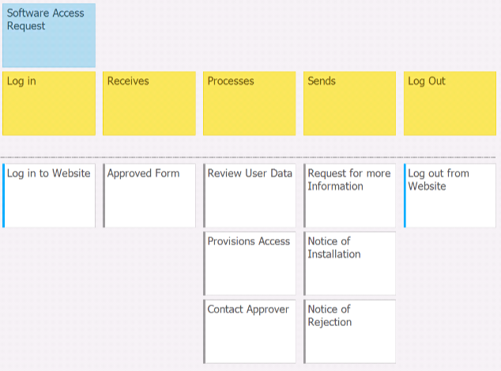
IT Analyst User Story Map
Team DCC: Dakota Fisher, Chengyu Lou, Connor Meredith

Slide 6
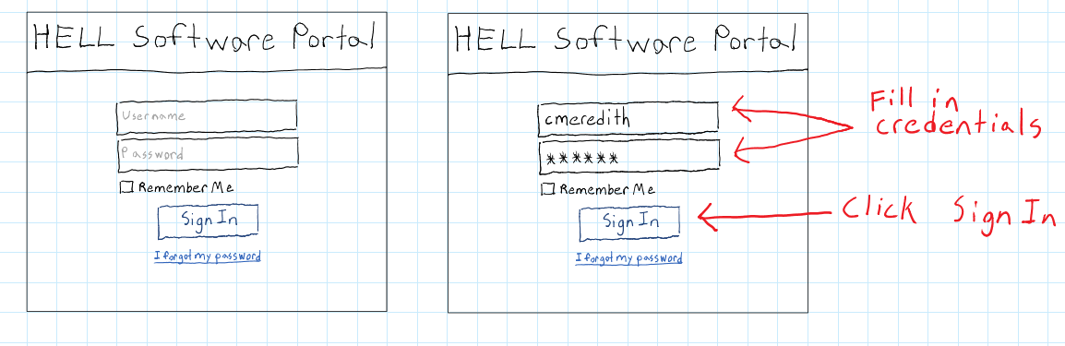
Important pages from lo-fi prototypes

Slide 7
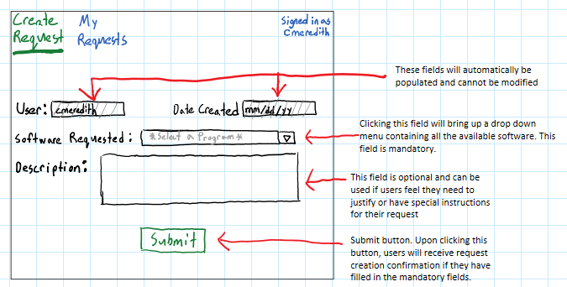
Important pages from lo-fi prototypes

Slide 8
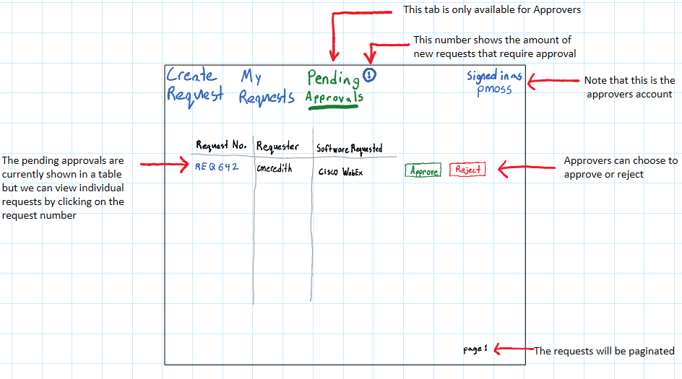
Important pages from lo-fi prototypes

Slide 9
ATDDs
User focus: Software Requester (All Users)
User story theme: Login
As a user I would like to be able to login to to the software portal so that I can make requests and check the status of my existing requests
Acceptance test-driven development criteria (ATDD) (positive/negative) | Failed | Passed
[P] Given the user has input the correct credentials, when they click the sign in button, the user should be redirected to the create request page |  | *
[N] Given the user has input invalid credentials, when they click the sign in button, the user should receive a popup notifying them that sign in has failed and then be redirected back to the sign in page |  | *

Slide 10
ATDDs
User focus: Software Requesters (All Users)
User story theme: Monitoring Status of Requests
As a user I would like to receive notifications whenever my software requests are approved, rejected, or completed so that I can monitor the status of my requests
Acceptance test-driven development criteria (ATDD) (positive/negative) | Failed | Passed
[P] Given that a request has successfully been submitted, when the request is approved, users should be notified that the state of the request has changed to approved |  | *
[P] Given that a request has been approved, when the request is completed, users should be notified that the state of the request has changed to completed |  | *
[N] Given that a request is submitted for software that a user does not qualify for, when the request is denied, the user should be notified that that the request has been denied and additionally the user should have access to optional notes that may explain why the request was denied |  | *

Slide 11
ATDDs
User focus: IT Analyst
User story theme: Access Provisioning
As an IT Analyst I would like to be able to provision access to users so they can access their software.
Acceptance test-driven development criteria (ATDD) (positive/negative) | Failed | Passed
[P] given they are on a tasks page when they provision access, they can record the completion. |  | *
[N] given they are on a tasks page, when they deny provisioning, the task is updated. |  | *

Slide 12
ATDDs
User focus: IT Analyst
User story theme: Finalizing Tasks
As an IT Analyst I would like to be able to send the user notice upon the completion of provisions to let them know they can use the software.
Acceptance test-driven development criteria (ATDD) (positive/negative) | Failed | Passed
[P] given the analyst has provisioned software, when they mark it as complete, the user’s ticket status is updated. |  | *
[N] given the analyst has provisioned software, and forgets to mark it as complete, it remains in their queue until marked as complete. |  | *

Slide 13
ATDDs
User focus: Software Requesters (All Users)
User story theme: Logout
As a user I would like to be able to logout of my account when I am not using it so that my account is not accessible to other people.
Acceptance test-driven development criteria (ATDD) (positive/negative) | Failed | Passed
[P] Given that a user is signed in, when they click the sign out button, the user should be signed out and then redirected to the sign in page. |  | *

Slide 14
Demo
Demo your group’s working tool
Compare with your group’s lo-fi prototype
Highlight MVP for release 1 (what was “done”)
Illustrate some of the Acceptance Test-Driven Development test validations

Slide 15
Design Patterns Used
Decorator Pattern
Navbar has base options available to all users
Additional options can be added to navbar for certain users depending on their access level
Example: Approvers will see an additional option on their navbar which give them access to a page displaying pending requests assigned to them
Notifications Pattern
Not discussed in class
Commonly used in UI design, particularly common for social media apps
Pattern used in our application to notify users when the status of a request has changed
Template Pattern
Forms

Slide 16
Group reflection
How did you feel about this milestone? What did you like about it? What did you dislike?
Likes:
Finally got to begin implementing our design
Finished the milestone with a working piece of software
Dislikes:
Much more work than previous milestones
What did you learn about yourself as you collaborated and worked through this milestone?
Importance of thoroughly planning before implementation

Slide 17
Group reflection
How will you use what you have learned going forward?
Use methodologies learned in class to ensure that the development of software goes as smoothly as possible
What “stuff & things” related to this milestone would you want help with?
Nothing in particular

